Slide 1
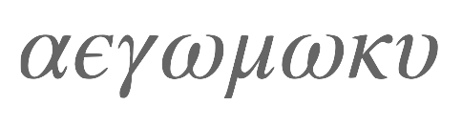
Alpha Epsilon Gomoku
Alpha (almost) Zero on a notebook

Slide 2
Alpha Zero

Slide 3
MCTS => PAGS Policy-Advised Graph Search
Monte Carlo Rollouts replaced by value advice.
Initial candidate selection (important!) by policy advice
Graph Search using upper confidence bound: UTC

Slide 4
Translational Equivariance

Slide 5
Board Representation

Slide 6
Symmetries/Equivariance
Symmetries provide inexpensive source of additional training data
Rotation multiples of 90°
Reflection
Translations!!
Black and White

Slide 7
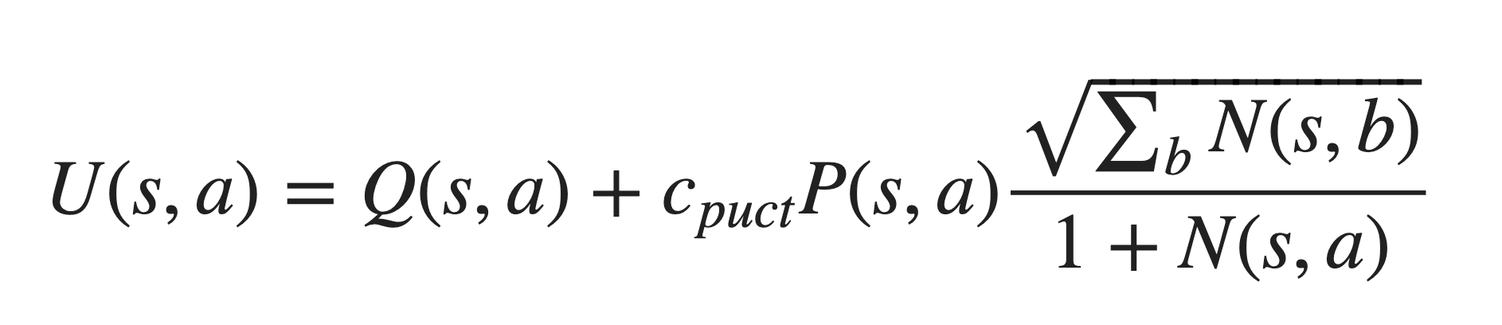
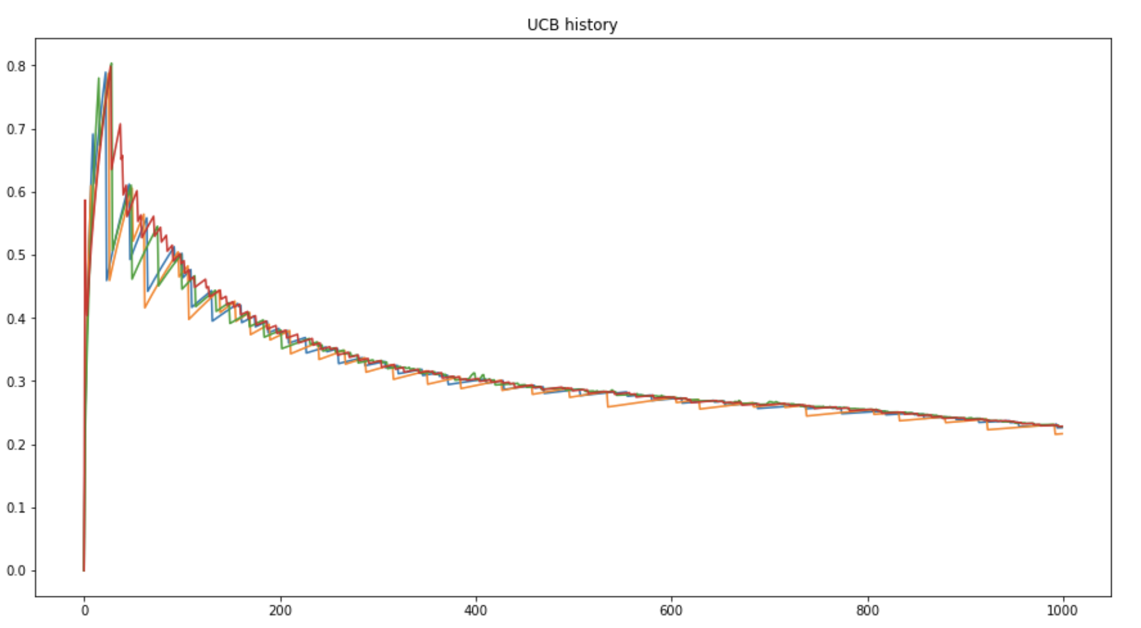
Upper Confidence Bound

Slide 8
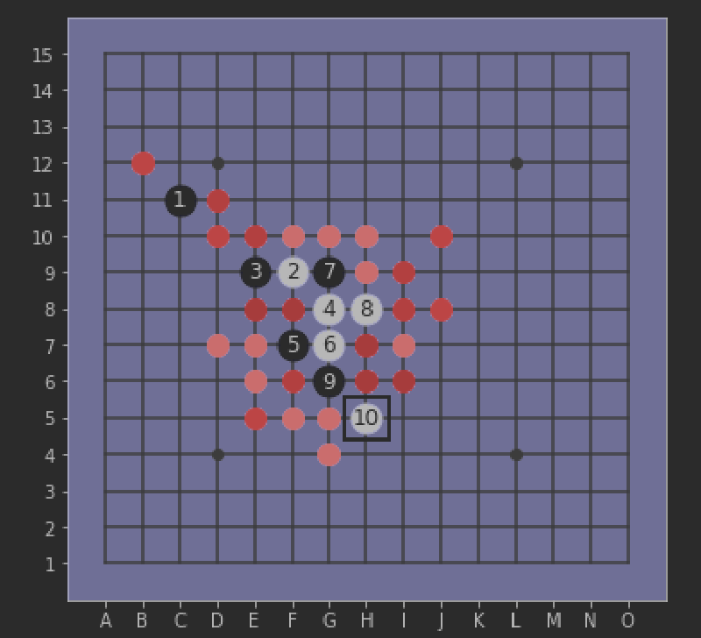
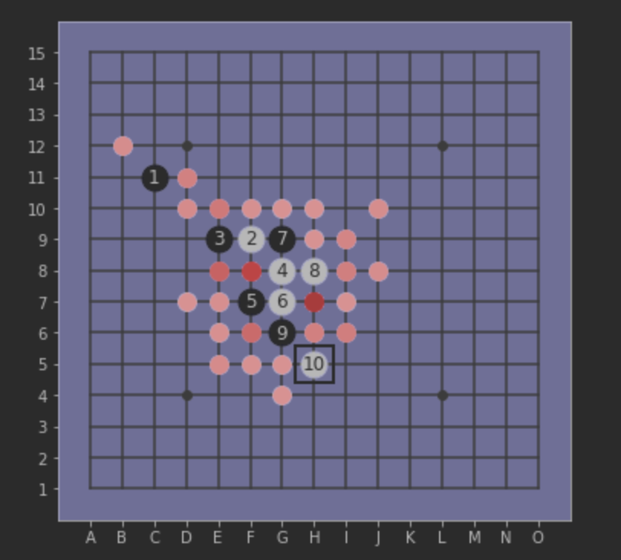
PAGS with UCT in action
See: MCTS_Explore_Exploit.ipynb
UCT Simulation teaches the ANN to focus

Slide 9
The Neural Network
Policy and value head in one network
Purely convolutional, apart from value head
Based on Resnet with skip connections
Up to 40 blocks
Feature head
Reentering input

Slide 10
Thinking Fast And Slow
Surprising similarity with human learning and decision making
Researchers now dare to compare human and artificial intelligence

Slide 11
Training Cycle
Selfplay and record the UTC output
UTC output draws knowledge from the ‘future’
Feed the UTC output into the ANN
ANN generalizes (surprisingly well!)
Better advice next time helps focus explorations
Arena: Let the better advice win

Slide 12
Thoughts on ANN&PAGS

